Slide 1
Employee Data Analysis using Excel
STUDENT NAME: Tamilarasi.M
REGISTER NO:DF28875361B89949F7645467953C9216
DEPARTMENT: Commerce
COLLEGE: Bharathi Women's college

Slide 2
PROJECT TITLE
EMPLOYEE DATA ANALYSIS

Slide 3


AGENDA
Problem Statement
Project Overview
End Users
Our Solution and Proposition
Dataset Description
Modelling Approach
Results and Discussion
Conclusion
3/21/2024 Annual Review

Slide 4

PROBLEM STATEMENT
Organizations struggle to manage their workforce effectively due to a lack of insights from employee data, leading to high turnover, low engagement, and inefficient resource utilization. The analysis of employee data aims to identify key factors affecting performance, satisfaction, and retention, enabling data-driven decisions that improve workforce management, optimize resources, and enhance overall organizational performance.

Slide 5

PROJECT OVERVIEW
Employee Data Analysis The Employee Data Analysis project aims to provide insights into workforce trends, performance, and demographics within an organization. By analyzing employee data, such as age, gender, department, job role, salary, tenure, and performance metrics, the project seeks to identify patterns that can inform decision-making. Key objectives include improving employee retention, optimizing resource allocation, enhancing productivity, and supporting strategic planning. The analysis utilizes data visualization, statistical methods, and predictive modeling to generate actionable insights, ultimately contributing to a more efficient and effective workforce management strategy.

Slide 6

WHO ARE THE END USERS?
The primary end users of Employee Data Analysis are HR professionals, management teams, and business leaders. HR teams use the insights to improve recruitment, retention, and employee engagement strategies. Managers leverage the data to make informed decisions about team performance, workload distribution, and employee development. Business leaders utilize the analysis to align workforce planning with organizational goals, optimize operational efficiency, and support strategic decisions. Additionally, data analysts and IT departments are key users who help interpret and implement findings to drive actionable outcomes.

Slide 7

OUR SOLUTION AND ITS VALUE PROPOSITION
1.Visualization Tools:Creates clear and insightful graphs and dashboards for easy understanding. 2.Trend Analysis:Identifies patterns in employee performance, attendance, and turnover. 3.Reporting:Generates automated reports with Excel templates to track key metrics Value Proposition: 1.Cost-Effective: Uses familiar Excel tools, minimizing the need for expensive software. 2.Easy to Use:Provides an accessible platform for HR teams without advanced tech skills. 3.Quick Insights: Delivers fast, actionable insights through Excel’s powerful analysis tools.

Slide 8
Dataset Description
1. **Employee ID**: Unique identifier. 2. **Demographics**: Age, gender, etc. 3. **Job Details**: Role, department, tenure. 4. **Salary**: Pay and bonuses. 5. **Performance**: Ratings and scores. 6. **Attendance**: Leaves and hours worked. 7. **Engagement**: Survey results. 8. **Training**: Programs attended. 9. **Turnover**: Employment status. 10.**Group,** This data provides insights into employee trends and performance.

Slide 9

THE "WOW" IN OUR SOLUTION
The "Wow" in our employee data analysis solution lies in its ability to deliver advanced, actionable insights. This includes predictive analytics for forecasting trends, sentiment analysis to gauge employee morale, real-time interactive dashboards, customized alerts for anomalies, and skill gap analysis for targeted development. These features transform raw data into strategic, decision-driving information.
3/21/2024 Annual Review
9

Slide 10
MODELLING
1. **Regression**: Predict outcomes like turnover or performance based on historical data. 2. **Clustering**: Group employees with similar attributes to identify patterns or segments. 3. **Pivot**: Summarize and analyze data dynamically using pivot tables to reveal trends. 4. **Forecasting**: Use historical data to project future trends or metrics. 5. **Visualization**: Create charts and graphs to present data insights clearly and effective
6.**Data Collection:**
Survey,HR Systems,Interviews,Time Tracking,Feedback Tools
7.**Data Cleaning:
Removing Duplicates,Handling Missing Values,Standardizing Formats,Correcting Errors,Validating Data.
10

Slide 11
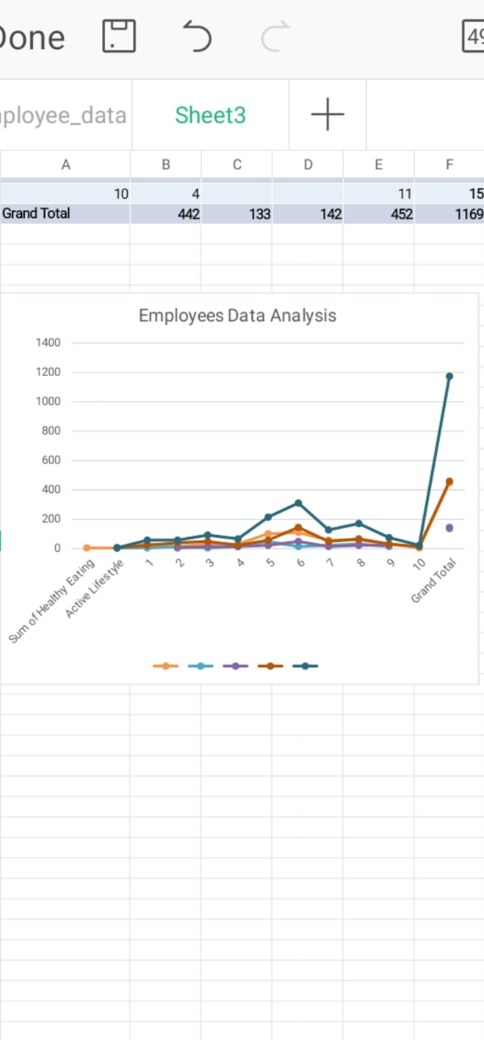
RESULTS
11

Slide 12
conclusion
**Conclusion:** The data analysis provides a comprehensive overview of employee performance, engagement, and satisfaction. Key findings indicate trends and patterns that highlight strengths and areas for improvement. By leveraging these insights, the organization can make informed decisions to enhance employee productivity, address concerns, and foster a positive work environment. Implementing targeted strategies based on this analysis will help in optimizing workforce management and achieving overall organizational goals. --- Feel free to adjust the specifics based on your actual findings!

